Slide 1
Board Update
Anti-Racism Policy

Slide 2
ACPS Anti-Racism Policy Statement​
Position Statement: The Albemarle County S​chool Board and School Division reject all forms of racism as destructive to their mission, vision, values and goals.​​​​
Equity Mission: ​​Albemarle County Public Schools is committed to establishing and sustaining an equitable community that achieves the School Division's ​equity mission to ​end the predictive value of race and ensure each individual student's and staff's success.

Slide 3
Background: The student-led policy group decided on 5 major activity categories for the policy, which translates to over 20 deliverables of varying size and scope.
Policy Communication
Leadership and Administration
Curriculum and Instruction
Professional Learning/Training
Policy Enforcement
Logic Model 1 & Logic Model 2
Notes:
We will use the 5 categories to help us monitor progress of the policy’s components and regulations

Slide 4
Steering Committee
Bernard Hairston
Jenn Sublette
Lars Holmstrom
Leilani Keys
Ayanna Mitchell
Jamie Gellner

Slide 5
Project Team
Bernard Hairston
Jenn Sublette
Lars Holmstrom
Leilani Keys
Ayanna Mitchell
Jamie Gellner
Lorenzo Dickerson
Phil Giaramita
Jay Thomas
Michele Castner
Daphne Keiser
Nick King

Slide 6
First Domains of Work
Policy Communication
Professional Learning/Training
Curriculum and Instruction
Leadership and Administration
Policy Enforcement
Logic Model 1 & Logic Model 2
Notes:
We will use the 5 categories to help us monitor progress of the policy’s components and regulations

Slide 7
First Deliverables: Partnerships to Create Products
Development of Policy Logic Model
Expansion of Professional Development
Design of Public Anti-Racism Statement Posting and Website for Parents and Students
Initial Work on Anti-Racism Curriculum Development and Evaluation Tools
Monitoring of Anonymous Reporting

Slide 8
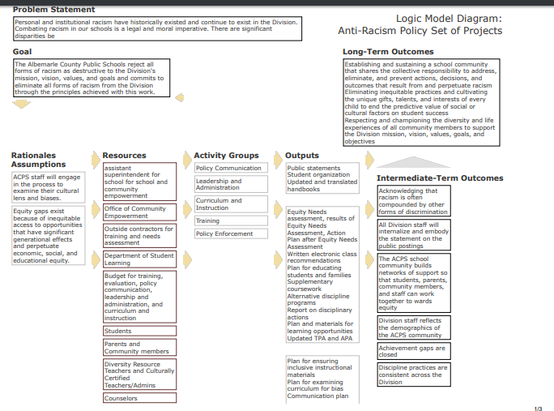
Logic Model &
Unpacking the Policy

Slide 9

Communication
Design of Public Statement
for Posting
Creation of Policy Website
Integration of Policy Website in School Site’s Parent and Student Resource Sections

Slide 10
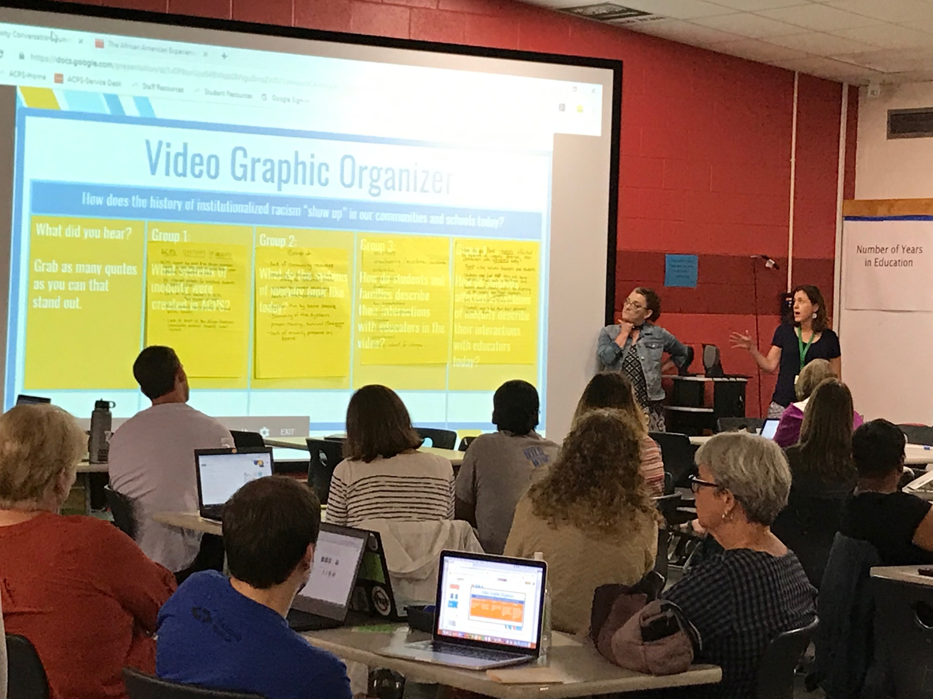
Professional Development - Initial and Ongoing
Division Level: Foundational Common Experience for All Teachers and Administrators
School Based: 18 Schools Engaged in Embedded CRT Professional Learning; DRT led PD in All Schools
Individual: 201 Educators Engaging in CRT Micro-Credentialing (85) and Certification (116) Process
Notes:
To Date - 40 Certified and 37 micro-credentialed
This year - 80 going for cert and 87 for micro

Slide 11
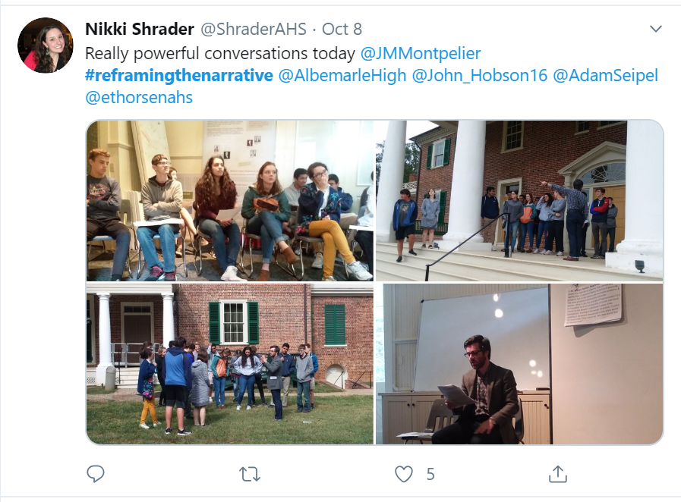
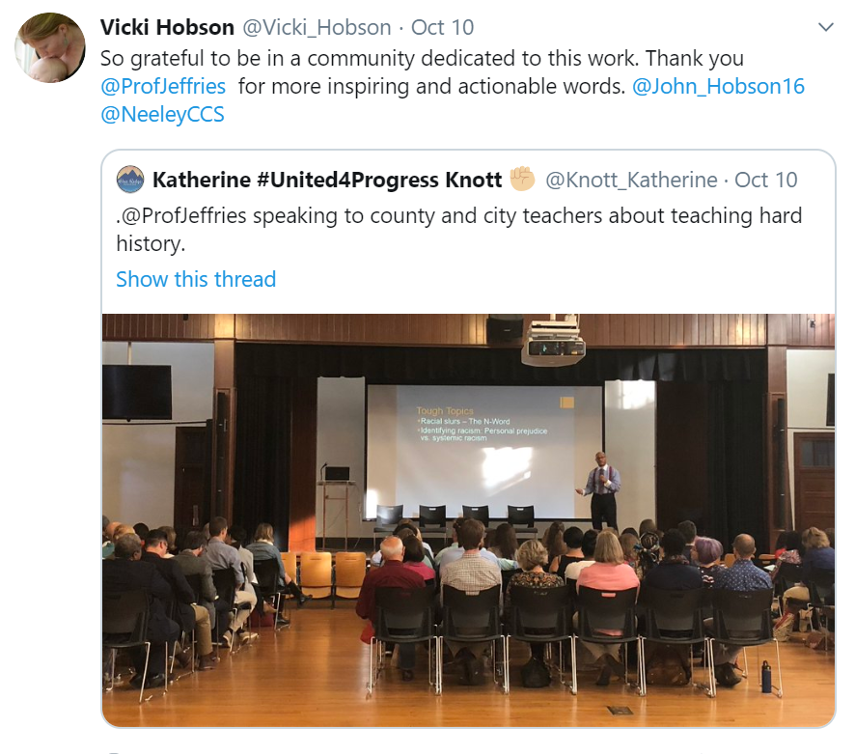
Anti-Racist Curriculum - Development and Tools
Initial cohort of US History Teachers (grades 6,7, and 11)
Professional learning to support deep work on curriculum and pedagogy
Development of exemplar units of instruction
Development of rubric for evaluating current resources and curriculum

Slide 12

Next Steps
Management of Project Teams
  Set schedule for next deliverables
  Create subcommittees for product completion
  Set strategic priorities for each subcommittee with timelines for each deliverable
Expanding Policy Training for Staff (Classified and Instructional)
  Goal of 100% by start of next school year for Classified
  Build on training offered to all bus drivers and EDEP staff
  Exploring digital formats for training

Slide 13
Next Steps: Examples of Deliverables
Leadership and Administration: Improve the system for school counselors to partner with teachers, students and families as equitable partners in the selection process and course sequencing
Communication: Kick-off of Student Diversity and Equity Committee
Professional Development: Expand Culturally Responsive Professional Development designed to support School Counselors
Curriculum and Instruction: Development and use of additional tools to evaluate current instructional and curricular resources
Policy Enforcement: Monitor Incident Reports of racism
Notes:
Development of components to build an “Equity Needs Assessment”
(Leadership and Administration)
Kick-off of Student Diversity and Equity Committee (Communication)
Culturally Responsive Professional Development designed to support School Counselors (Professional Development)
Development and use of additional tools to evaluate current instructional and curricular resources (Curriculum and Instruction)
Update on Incident Reports for 2019-2020

Slide 14
Next Update:
January or February 2020

